Slide 1
Cambridge TECHNICALS Unit 02 – Global Information LEVEL 3 - 2016
2.5 - Understand the process flow of information

Slide 2
RELATED ACTIVITIES
e
This unit | Title of suggested activity | Other units/LOs
LO5 | Information sources and data types Impacts affecting the flow of information in information systems | Unit 2 Global information | LO3 Understand the use of global information and the benefits to individuals and organisations LO4 Understand the legal and regulatory framework governing the storage and use of global information
 |  | Unit 2 Global information | LO2 Understand the styles, classification and the management of global information LO4 Understand the legal and regulatory framework governing the storage and use of global information

Slide 3
RELATED ACTIVITIES
e
Explanations of the key terms used within this unit, in the context of this unit
Data | Data is information that has been coded and structured in some way, ready for processing, storage, transmission, etc. Data has no context and has no meaning. Examples of data could include: shoe size stored in the stock database of a shop, a date, etc.
Global divide | The divide that exists in terms of access to information between different countries and different types of holders of information across the world.
Green IT | The practice of reducing energy use by IT equipment and thus improving sustainability. This relates to both individuals and organisations. The main purpose of Green IT is to increase the sustainability of IT equipment and operations. Examples of Green IT range from an individual using their PC power settings to automatically switch off the screen after a certain time with no keyboard/mouse activity, up to the virtualisation of a large, global organisation’s data stores to reduce the number of servers in their data centres.
Holder of information | Any individual or organisation that holds information
Information | Information is data that has been given context and meaning in some way (e.g. by processing, storing or transmission). An example of information is: a shop receipt showing the model, price and size of shoes, together with the time and date of the purchase
Information formats | The different ways in which information can be presented using world wide web (www) technologies. Examples of information formats are: web pages; RSS feeds; podcasts; blogs; and social media channels.
Information style | The style of information, regardless of the technology used. For example, the audio information style could be represented by spoken instructions, an MP3 music file, a DVD soundtrack or a podcast. Many, but not all, of the information styles will have a corresponding information format on the world wide web.

Slide 4
Assignment Scenario
There are 3 sections to this Theory Unit, each of which will give you a basic understanding and practice at possible exam questions. It will involve gaining knowledge towards the answers.
This is not a wrote learning course, you will need to understand the basics of ICT in order to adapt your knowledge towards companies and their needs. For LO5, this will involve understanding:
Information sources and data Types
Data flow diagrams (DFD)
Impacts affecting the flow of information in information systems
In the exam you will be given precise questions requiring precise answers based on a scenario to answers questions from, and adapt your knowledge and use the key terms and named components to give a judgemental answer.

Slide 5
5.1 - Information sources and data types
They say that information is key, the lifeblood of an organisation, without it a company works alone, independent of the outside world, immune to trends, to sales projections, to the changes in customers and opinions, to advances in technology. Information is power, and a critical resource for performing within organisations.
Business managers spend most of their day in meetings, reading, writing, and communicating with other managers, their staff, customers, suppliers, and other business associates via telephone, in person, or by e-mail. The management function itself is information processing. It involves gathering, processing, and disseminating information. Managing information involves coping with a wide range of information sources before finally making decisions about what to do with it.
A manager must track and react to information flowing from sources inside and outside the business. The manager processes this river of information and disseminates it in one of four ways: stores it, uses it, passes it on, and/or discards it, e.g., during the course of a normal business day, a marketing manager for an IT company receives information in the form of e-mail, telephone calls, letters, reports, memos, trade publications, and formal and informal conversations.
All these are used to benefit the company and they better they are processes, the faster, the more usable and readable the format, the better the business function.
Different kinds of information in the world Different kinds of information within the departments of a company How easy it is to access information now With phone and portable internet, all information is instant How can Apps change what we read Is there an App for everything.

Slide 6
5.1 - Information sources and data types
Sourced location of information can be split into two distinct places; internal and external, both with their merits and issues. Companies will use both locations for bets effect and few companies will work independently of both. Supermarkets have suppliers as well as customers, factories are still the middle men for raw materials and customers.
Internal (e.g. financial reports, market analysis) These include:
Financial Information: this is information related to the performance and profit and loss of the company. This will include information on how much you pay for items, how much you pay staff, the costs of rates and the taxes that you pay as a business.
Personnel Information: This is information held by the company on their employees. This information must be freely available to the employee any time that they request it.
Marketing Information: this is used by the marketing team to identify what products or services offered are most successful. They collect information from different departments such as sales to promote certain products or services based on current success rates.
Purchasing Information: this is collected by the purchasing department who are involved with buying all of the products needed to run your business.
Sales Information: this needs to be monitored based on the product or services offered by your company. This information needs to be passed to ensure that the cost of your good or service is less than the sale price.
Manufacturing information: This is information about the cost of manufacturing goods within the company and will normally include the running cost of all machinery, the wages paid to production staff and the cost of raw materials used up in the manufacturing process.

Slide 7
5.1 - Information sources and data types
External: Examples of external information sources are: Government, trade groupings, commercially provided information, database and research. If a company uses external sources of information then they must be sure of the reliability of the data sources. Here are some examples of how the company could use information supplies by external sources:
Government: This comes from a reliable source as this is the governing body that they business operates within. Companies need to use important legal information from the Government to help run the business successfully and legally. For example, if the Government offered businesses grants for opening manufacturing plants in areas of high unemployment a company might use this information to their advantage to set up a new plant at a lower cost than in another area.
Trade Groupings: This is a group of businesses that operate within the same sector and not within the same location. For example tech companies would be part of the Technical Trade Association and Farmers part of the Farming Association within a country or region. As a business being a member of a trade grouping enables you to access information that helps you run your business successfully. For example, solicitors are part of the legal trade and will have memberships that give them access to the latest laws that the must use to support their clients in the best possible way.
Commercially Provided: Companies can use this information to help them make the correct business decisions. These decisions are made based on information made available to them from other companies. For example, a hotel group might use the information about the number of flights to and from a number of airports along with the information on the number of hotels beside each airport to make a decision on where to open their newest hotel.
Databases & Research: Companies can research information that might help them increase the sales and level of interest in their business. The key thing to researching information that helps run your business to ensure it is accurate and reliable. Some companies will pay to access commercially available databases that offer a range of information directly based on their business sector.

Slide 8
5.1 - Information sources and data types
Sourced information can be split into two distinct categories; primary and secondary, both with their merits and issues.
Primary research (field research) involves the collection of data that does not already exist. This can be achieved through numerous forms, including questionnaires and interviews. This is research the company carries out itself, with its own staff, for its own purpose. There are obvious benefits to this kind of research:
Can be tailored to the companies needs
Company can control the flow of information
Can be adapted on the spot to gauge additional opinion
There are many pitfalls for this type of research:
Could be very expensive because many people need to be contacted.
Take a long time and be out of date when the research is complete.
People may not reply if emails or letters used.
Secondary research (desk research) involves the summary or collation of existing research rather than primary research, where data is collected from, for example, research subjects or experiments. Basically using someone else’s primary research to aid your own research problem. The benefits include:
Companies hired know what they are doing and where to look for information
Companies hired can analyse information
It is easier to get someone else to do the work
Does not require additional staffing
Disadvantages include:
Can be expensive
Relies on the honesty of the external body
Can be too specific and non adaptable.
Can Information be Secondary and External Why does a 2 minute survey take 20 minutes What is wrong with Internet information How could Brexit polls have got it so wrong 79% of statistics are made up like this one Would voting be easier if it could be done with an App and biometircs.

Slide 9
5.1 - Information sources and data types
Sourced information can be split into two distinct types of response; qualitative and quantitative, both with their merits and issues.
Qualitative methods are ways of collecting data which are concerned with describing purpose and meaning, reasons for things, rather than with drawing statistical responses. What qualitative methods (e.g. case studies and interviews) lose on reliability they gain in terms of validity. They provide a more in depth description, opinion based responses that can be used to judge why rather than how many. Examples include Why, How, For what reason, In your opinion etc.
Quantitative methods allow for statistically reliable information obtained from numerical measurement to be backed up by and enriched by information about the research participants' explanations. They are results that can be calculated, formulated, put into Spread sheets and drawn up, used as information that can be queried, sorted and defined against previous and future information. Examples include Yes/No, out of ten, > or <. Even single answer responses can be added up if there is a restriction on the possible responses.
Task 1 - Describe the features of Information Sources and outline the advantages and disadvantages of each.
Can Information be Secondary and External Why does a 2 minute survey take 20 minutes What is wrong with Internet information How could Brexit polls have got it so wrong 79% of statistics are made up like this one Would voting be easier if it could be done with an App and biometrics.
Internal | Qualitative | Primary
External | Quantitative | Secondary

Slide 10
5.1 - Information sources and data types
Task 02 - For the following pieces of Information or Data describe what form to it will be sources from, what data types it will come in, whether it is information or data, which department is likely within a business to access and use this information and how it will benefit the business.
Example below:
Supplier price lists; the names of employees; expiry date of a medicine; interest rate charged on a loan from a bank; magazine article on a company profile; student grade in a mock exam; Foot size measurements taken by a shoe shop; government exit polls; xBox live account figures; shop clocking in card; supermarket loyalty card use; social media likes; YouTube hits; parent call to school receptionist; barcode scan; Online survey completed by customers; rfid tracking; Names of donors to a charity; vehicle weight measure at a port; Feedback received from customers on a third party review website.
Can Information be Secondary and External Why does a 2 minute survey take 20 minutes What is wrong with Internet information How could Brexit polls have got it so wrong 79% of statistics are made up like this one Would voting be easier if it could be done with an App and biometrics.
Source | Data Type | Data or Info | Who sources | Company Benefits
Sales figures | Primary, Qualitative and Internal | Data | Sales department, possible marketing | Can be used to determine product worth, popularity, whether sales are increasing or decreasing
Internal | Qualitative | Primary
External | Quantitative | Secondary

Slide 11
5.2 - Data flow diagrams (DFD)
Data flow diagram(DFD) is a diagram of the movement of data between external entities and the processes and data stores within a system
May look similar to a flow chart
Shows that there is a flow of data between the two components (one-way or a two-way flow)
Component sending data can send multiple sets of data along several connections
In fact, a DFD node can be a component that never ends
Rules
In DFDs, all arrows must be labelled
The information flow continuity, that is all the input and the output to each refinement, must maintain the same in order to be able to produce a consistent system.

Slide 12
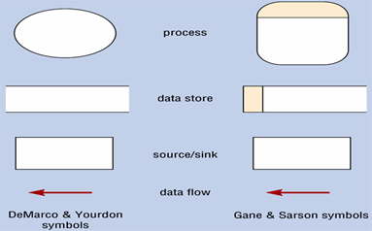
5.2 - Data flow diagrams (DFD)
Entities:
Can be people, departments, other companies, other systems…
Are called sources if they are external to the system and provide data to the system, and sinks if they are external to the system and receive information from the system
Processes
Must have at least one input and at least one output
Data stores:
Labelled as hard copy or source of data it is referring to
Data flows:
Must originate from and/or lead to a process (this means that entities and data stores cannot communicate with anything except processes –remember that it takes a process to make the data flow)
Can have 2 arrowheads when a process is altering (updating) existing records in a data stores.

Slide 13
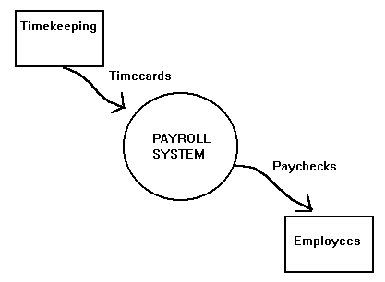
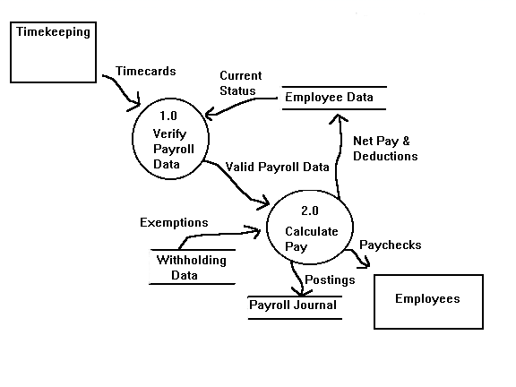
5.2 - Data flow diagrams (DFD) – Level 0
The DFD may be used for any level of data abstraction.
DFD can be partitioned into levels. Each level has more information flow and data functional details than the previous level.
The highest level is the Context Diagram, here are some important points:
1 bubble (process) represents the entire system
Data arrows show input and output
Data Stores are NOT shown ➔ They are within the system
The next Level is called Level 0 DFD, here are some important points:
must reflect the context diagram (detailed)
Input going into a process
Outputs leaving the process
Data stores are first shown at this level

Slide 14
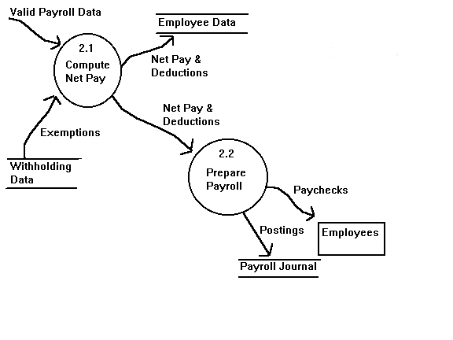
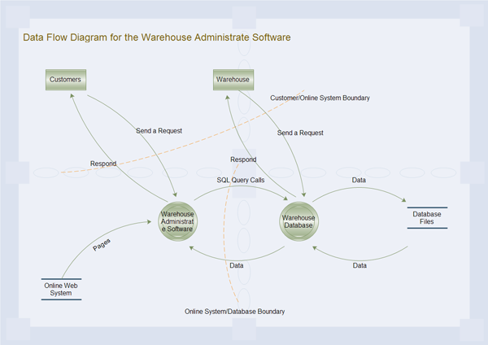
5.2 - Data flow diagrams (DFD) – Level 1
The next Level is called Level 1 DFD, here are some important points:
must reflect the Level 1 DFD (in more detail)
Focus on a specific process within the system
What Level is this DFD representing the activities at?

Slide 15
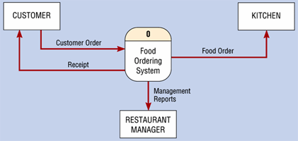
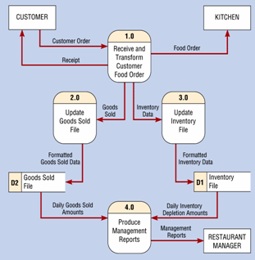
5.2 - Data flow diagrams (DFD) – Level 1
Task 03 - Explain the activities taking place
Task 04 - Explain the activities taking place

Slide 16
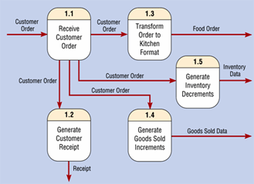
5.2 - Data flow diagrams (DFD) – Level 2
Task 05 - Explain the activities taking place
How can information be streamlined How many people get involved in one student complain Where does the buck stop Does having access to SIMS for a student help them Should parents be allowed to access the students reports Is too much information bad.

Slide 17
5.2 - Data flow diagrams (DFD) – Tasks
Task 06 – Explain what a Data Flow Diagrams (DFD) are
Explain the 3 different levels
State the type of DFD symbols you plan to use
Task 07 - Present Data Flow Diagrams (DFD) for 2 of the following scenarios, showing how your business’s information system works and information flows through the different areas of the business
Payroll
Recruitment
Credit Control
Customer Complaint
Web Transaction
eMail
Task 08 - Within a Presentation demonstrate the Input and Output information flow of your three DFD’s explaining the kind of information used, the method of MS management and the resulting information flow from this.
Click on the Link here to follow a guide. Scenarios to use are on the last slides or click here for an online guide.

Slide 18
5.3 - Impacts Affecting the Flow of Information
Task 09 – On the next slide there are 4 scenarios, identify what the DFD shows, the information sources, inputs, flows and outputs of information, what level of DFD they are and why and how might the processes of information flow for the given scenarios be streamlined.
Task 10 – Using the understanding gained in this Learning Outcome with that from other Los, write a report on the impacts affecting the flow of information in information systems, to include reference to the following:
Information sources
Data types
Data flow diagrams
Information quality (LO2)
Legislation and regulation (LO4)
Information classification (LO2).
This should be created like a report with the different headings above, you should choose a scenario like a school or hospital or supermarket, outline a specific scenario within that organisation, e.g.:
A parent has rung in complaining that their child is getting too many detentions from one particular teacher and that teachers is grading their child’s work too harshly.
A customer in a supermarket has asked an assistant for more milk as there is not enough left on the shelves.
A patient with recurring symptoms consults a different doctor that their usual one.
How can information be streamlined How many people get involved in one student complain Where does the buck stop Does having access to SIMS for a student help them Should parents be allowed to access the students reports Is too much information bad.

Slide 19
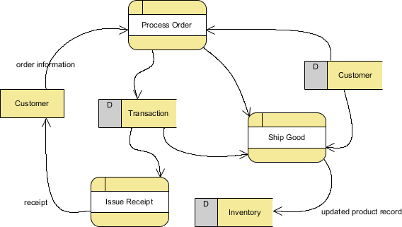
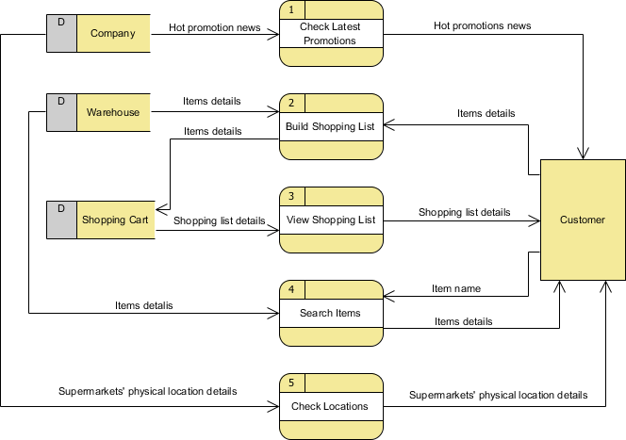
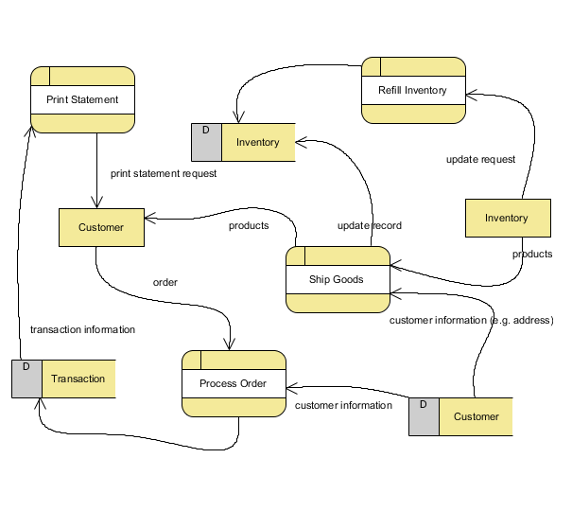
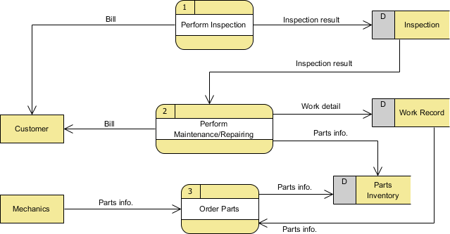
5.3 - Impacts Affecting the Flow of Information
1
2
3
4

Slide 20
5.3 - Impacts Affecting the Flow of Information - Legal
When inputting information the legal implications have to be considered as there are two users now involved, those who type in the information, those who store the information and those who access the information. You would not expect the network technicians to have the same levels of clearance as the managers but they have access to the information on the network.
Consider the Data Protection Act, the Computer Misuse Act and the Freedom of Information Act, and the difficulties in monitoring staff activities in the process of information input, use and transfer.
What the information flow is
The lines of communication flow in terms of Data, people, hardware, Software, Communication Flow, Input, Processing, Reporting, Analysis, Closed and open systems.
How effective is the flow of information you have designed.
What lines could be removed to improve efficiency.
Legal Implications
Ethical Implications
Task 11 - Analyse the legal implications that need to be considered when dealing with information/data within your businesses system (inputs/outputs)

Slide 21
5.3 - Impacts Affecting the Flow of Information - Ethical
Similarly the ethical implications of inputting, processing and managing information in businesses. Using your DFD diagram, discuss and analyse the ethical issues concerning the information input and output in terms of Whistleblowing, Disability, the Use of information, Emailing information, Placing information on public view, and codes of practice.
By this we mean the moral obligation staff have when they input the information or use the information. It is human nature to look, to peek, to comment but this is private information, knowledge of sales information for instance can benefit rivals, commenting on disabilities happens, emailing private information might seem secure but emails get read all the time by others, accidently or through redirection and mistake.
Task 12 - Analyse the ethical implications that need to be considered when dealing with information/data within your businesses system (inputs/outputs)
How can information be streamlined How many people get involved in one student complain Where does the buck stop Does having access to SIMS for a student help them Should parents be allowed to access the students reports Is too much information bad.

Slide 22
5 – Exam Questions – Specimen Paper
9. Here is a data flow diagram showing how to apply for a place at a school.
(a) State one process shown in the data flow diagram.
_______________________________________________________________ [1]
?

